Slide 1
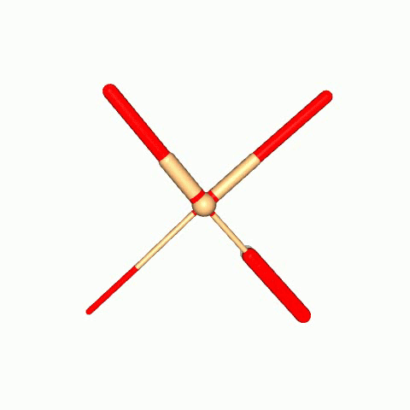
Co-Evolution of generalist morphology and control for diverse environments
Kubilay Tarhan
Supervisor: Anil Yaman

Slide 2
Main question
Can we co-evolve a morphology-controller pair that exhibits both generalist characteristics and behavior to achieve high performance across a wide range of diverse environments?

Slide 3
Importance and motivation
Evolving morphology-controller pairs
01
Evolving generalist morphology-controller pairs
02
Notes:
Evolving morphology-controller pairs
More effective AI agent systems, due to embodied cognition
Avoiding conventional physical design stage
Evolving generalist morphology-controller pairs
Practicality due to real-world being dynamic and unpredictable providing more reliability

Slide 4
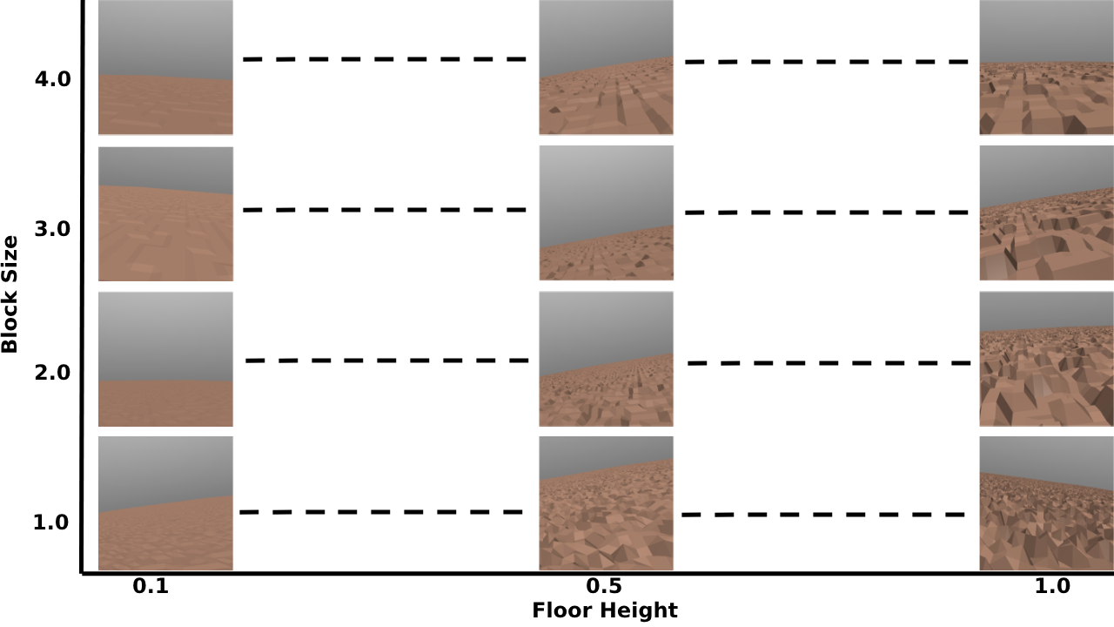
Notes:
Total of 85 environments

Slide 5
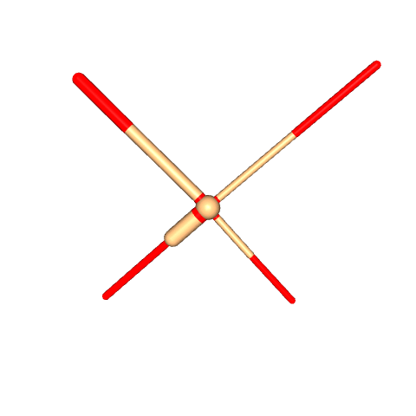
Morphological parameters
4 legs each 2 parts
Each length and width
Total: 16 parameters

Slide 6
Algorithm
Initialize T, G, E
Generate population and evaluate on t in T
Identify best MC-pair, calculate generalist score and save if highest
Update search parameters
If termination conditions met, then partition E
Save best MC-pair in G
Save partitioned environments from T in E

Slide 7
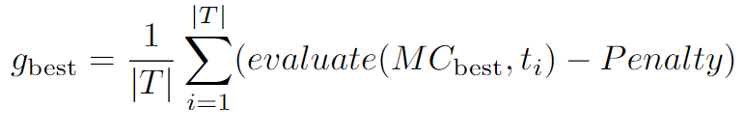
Penalty
Generalist score

Slide 8
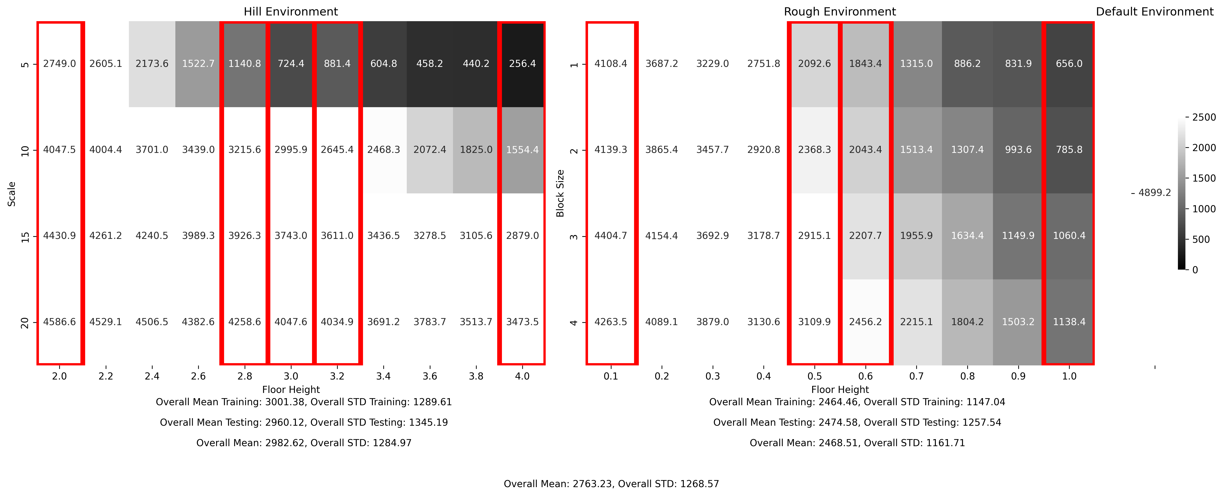
Experiment 1: One generalist

Slide 9
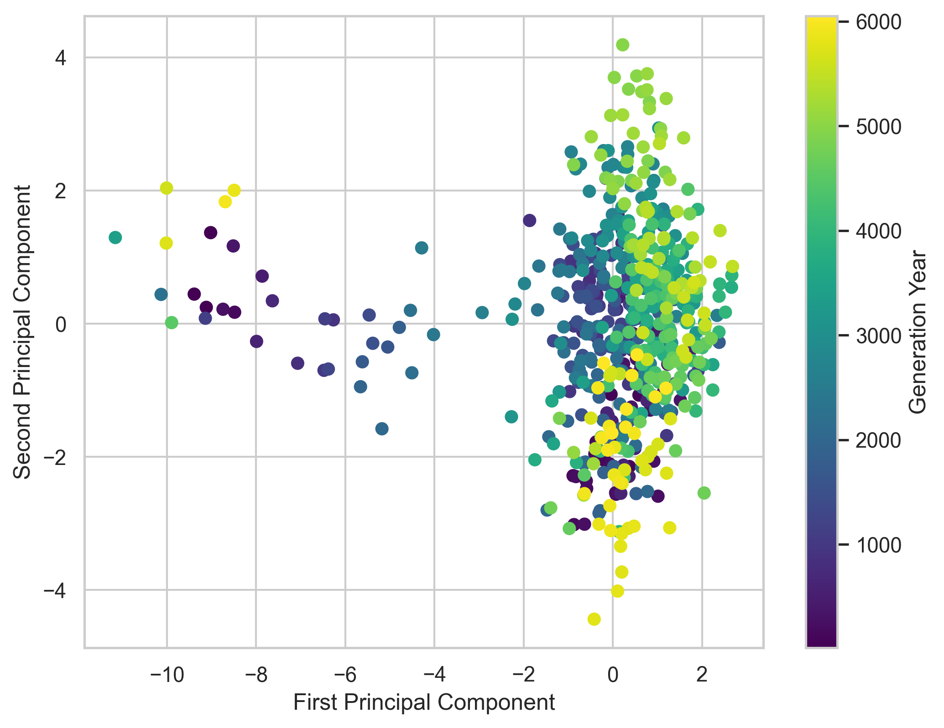
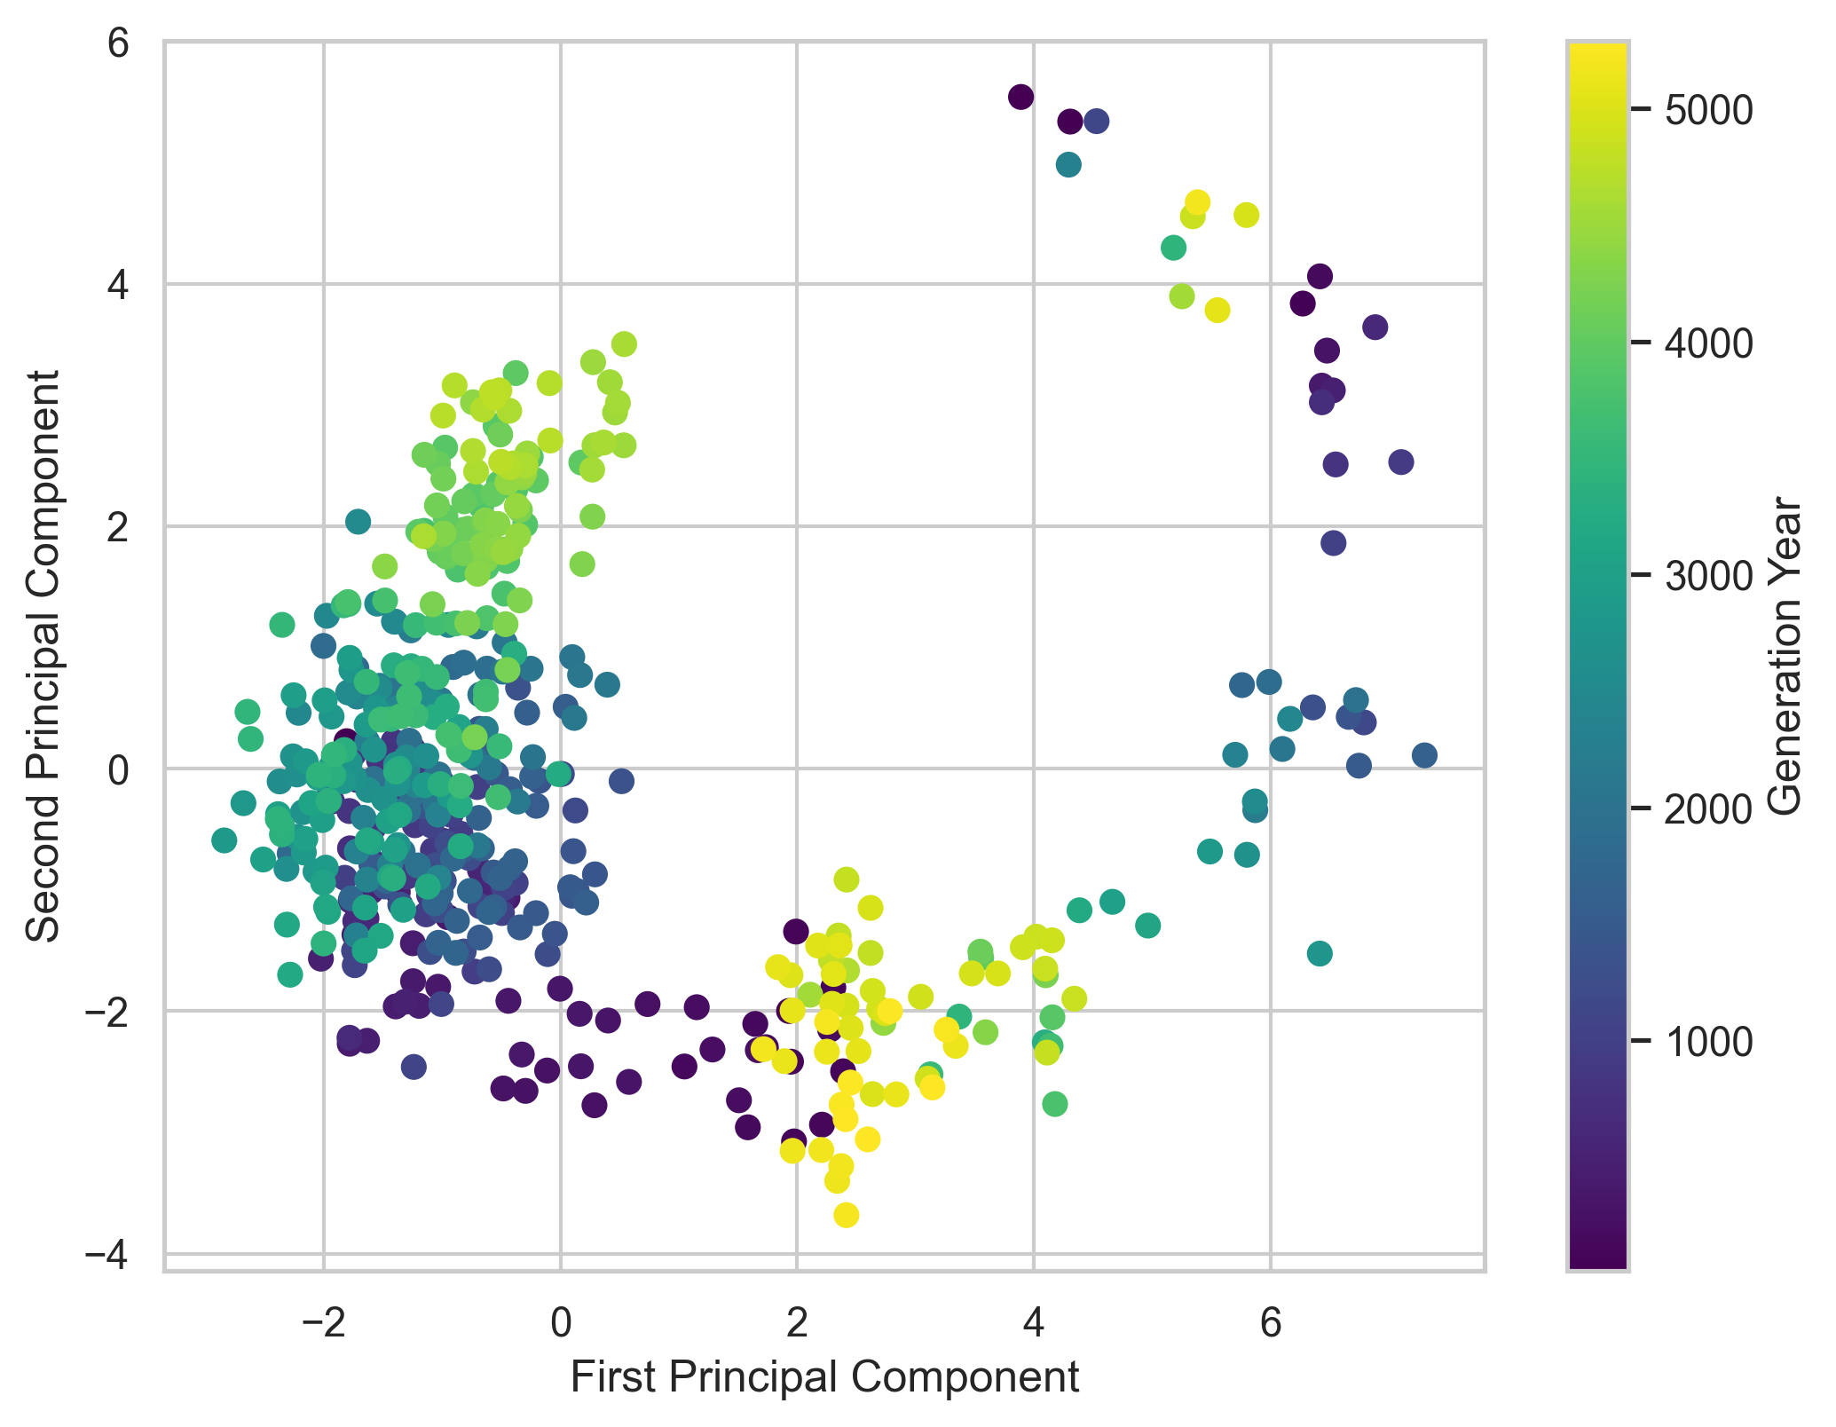
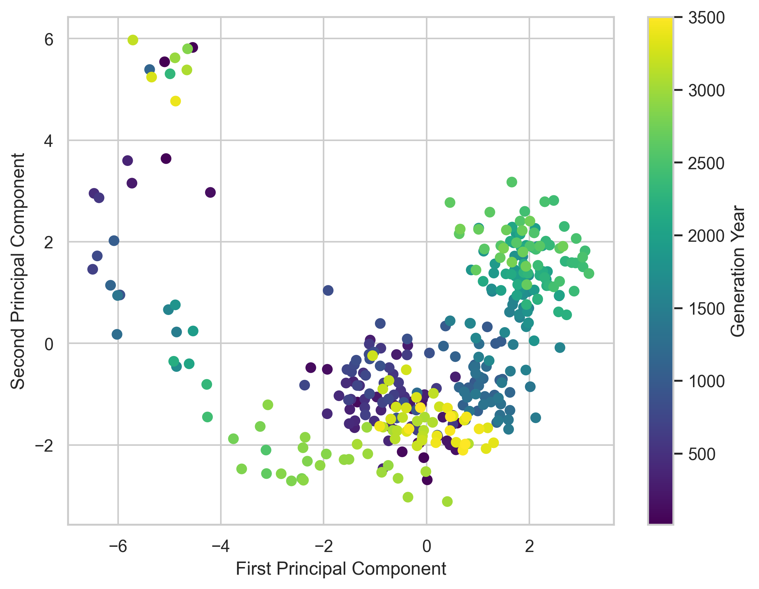

Slide 10
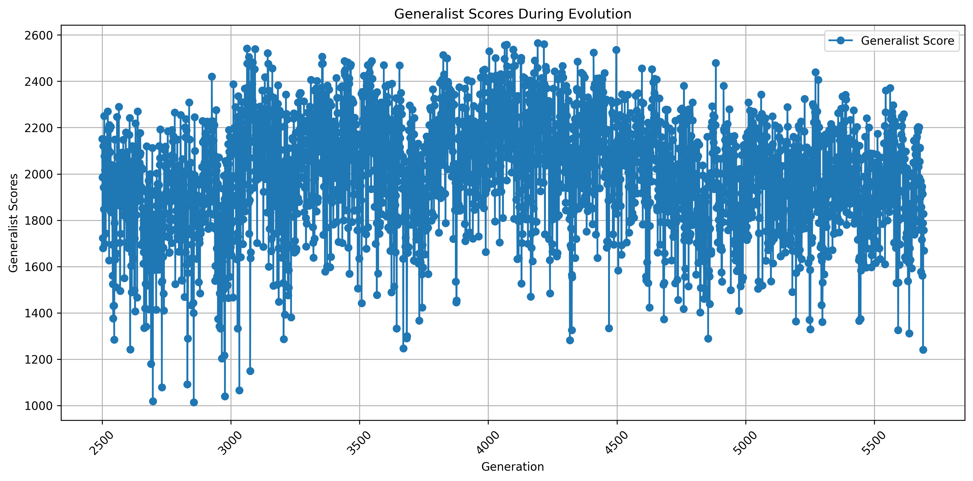

Slide 11
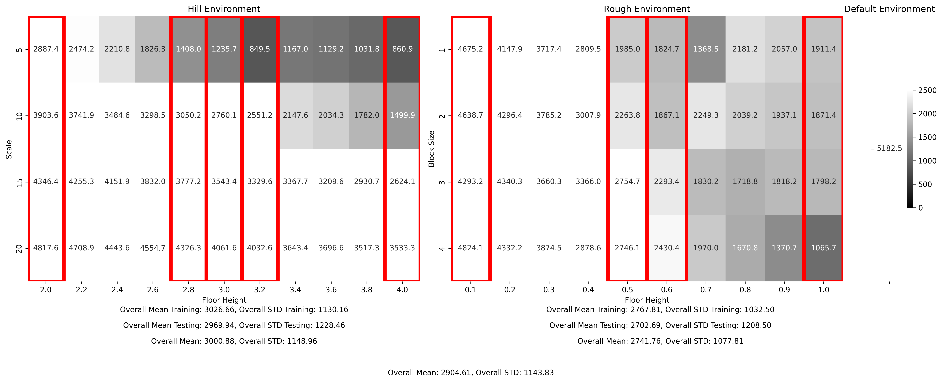
Experiment 2: Partition for generalist

Slide 12
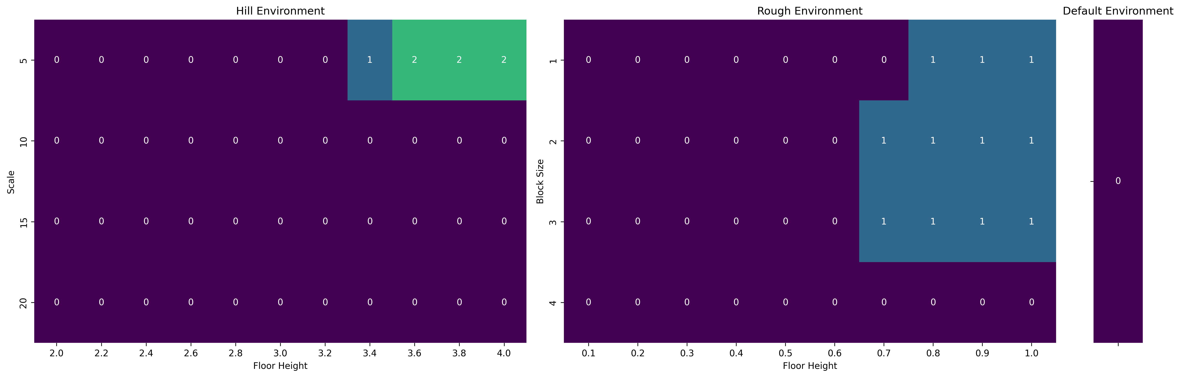

Slide 13
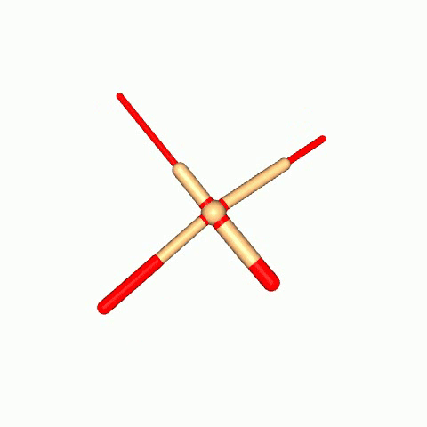
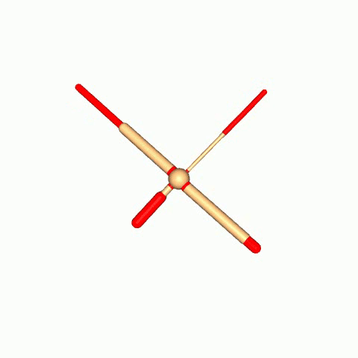
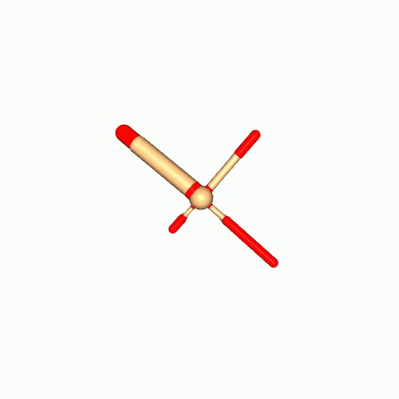
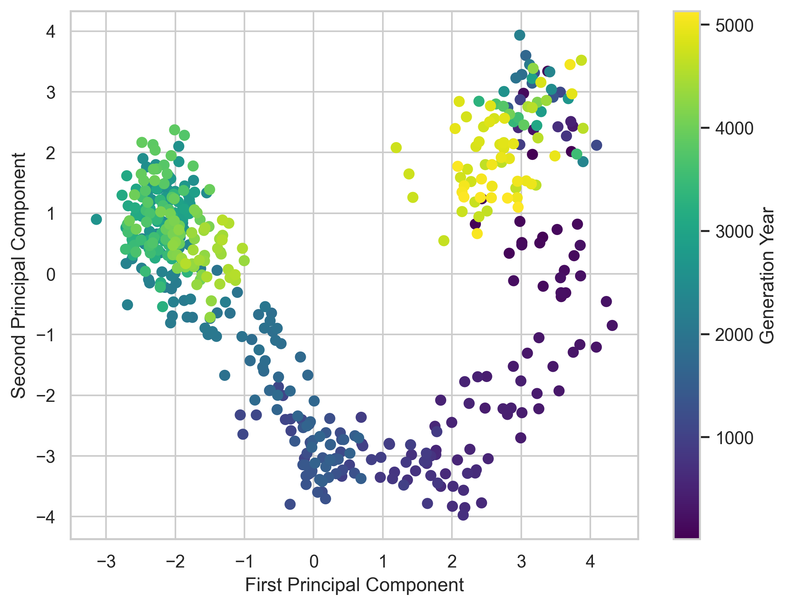
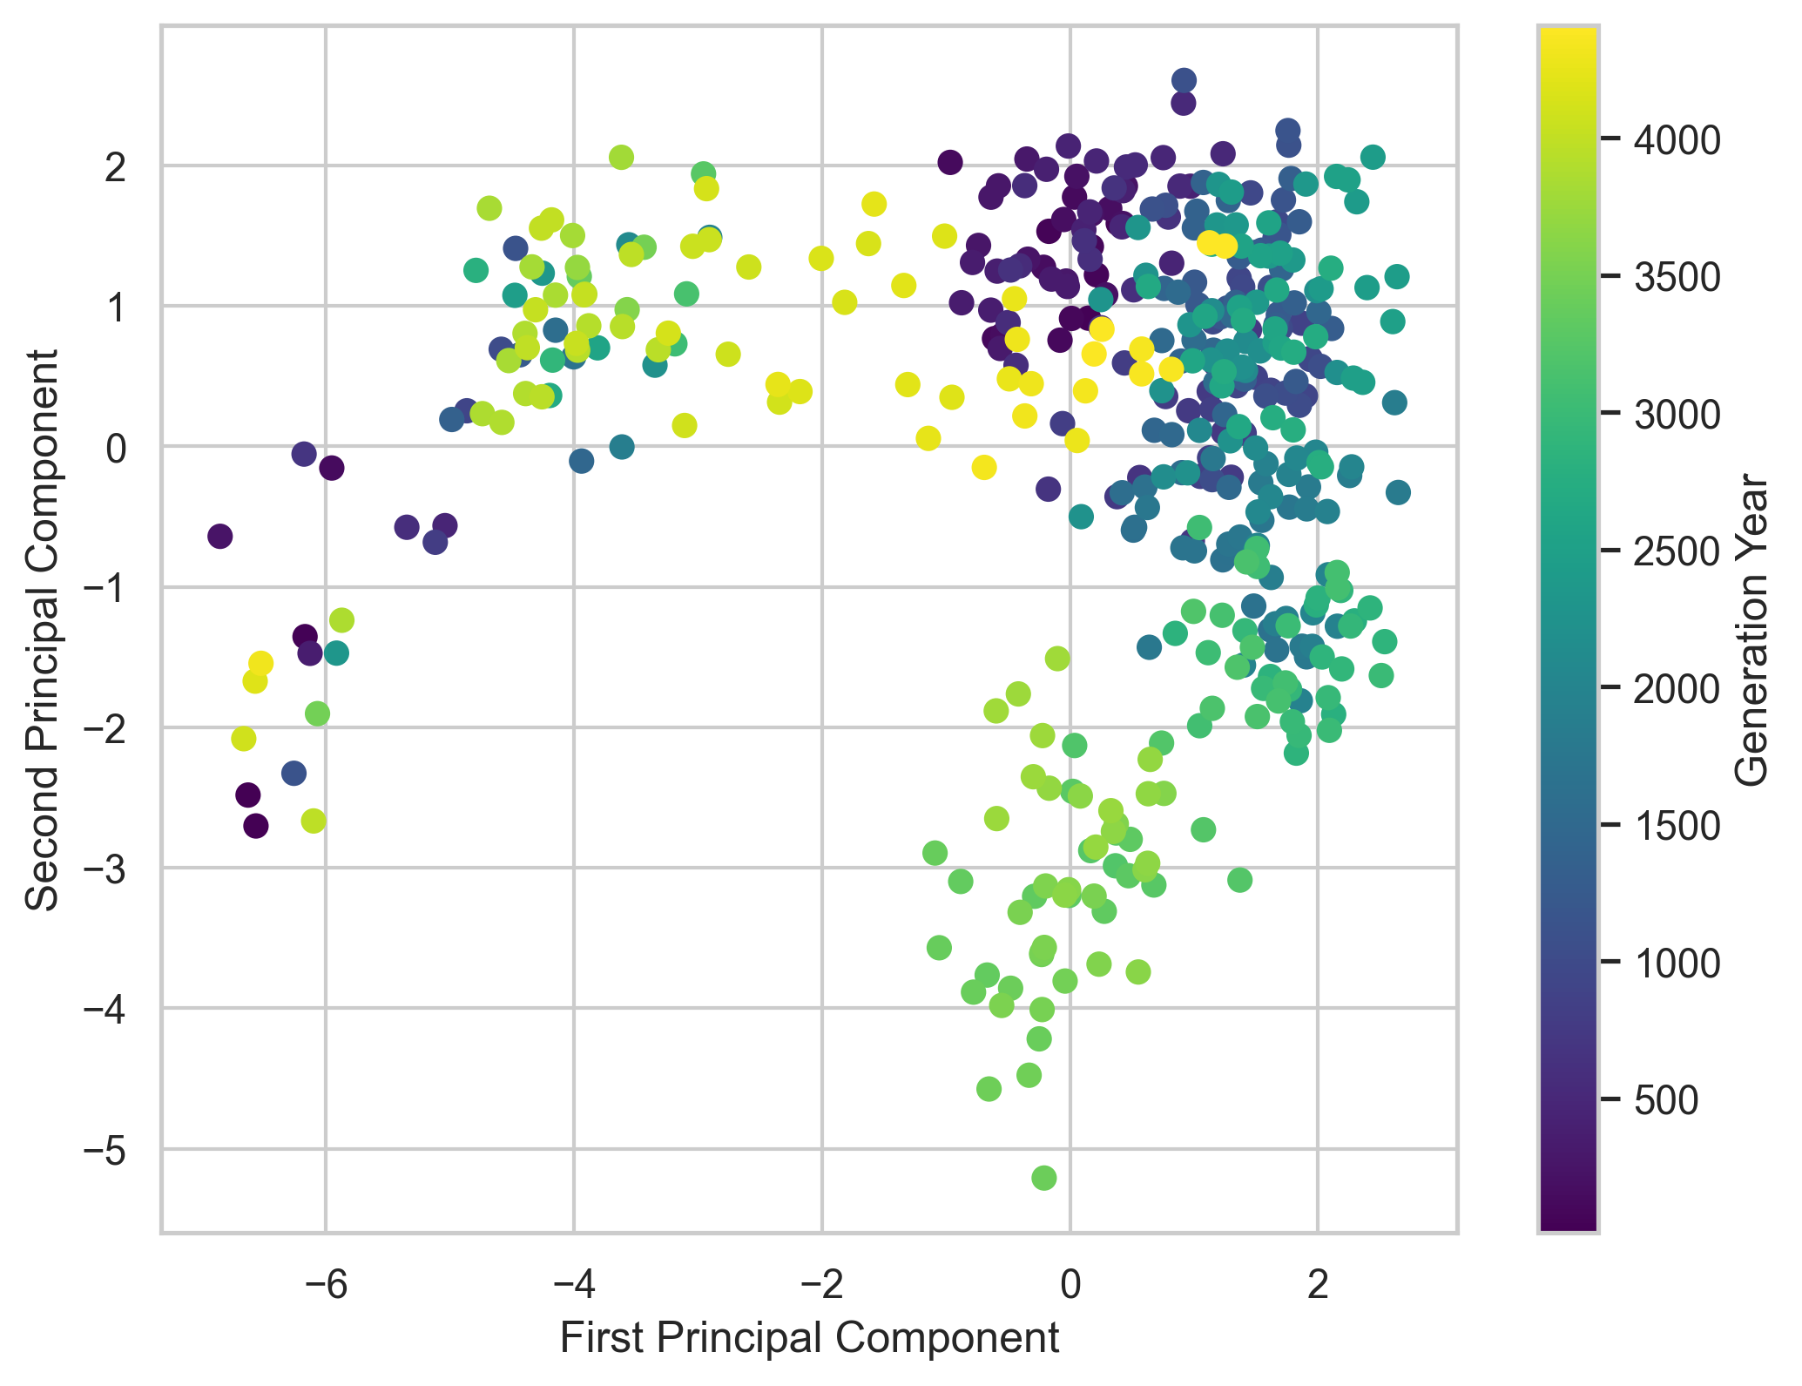
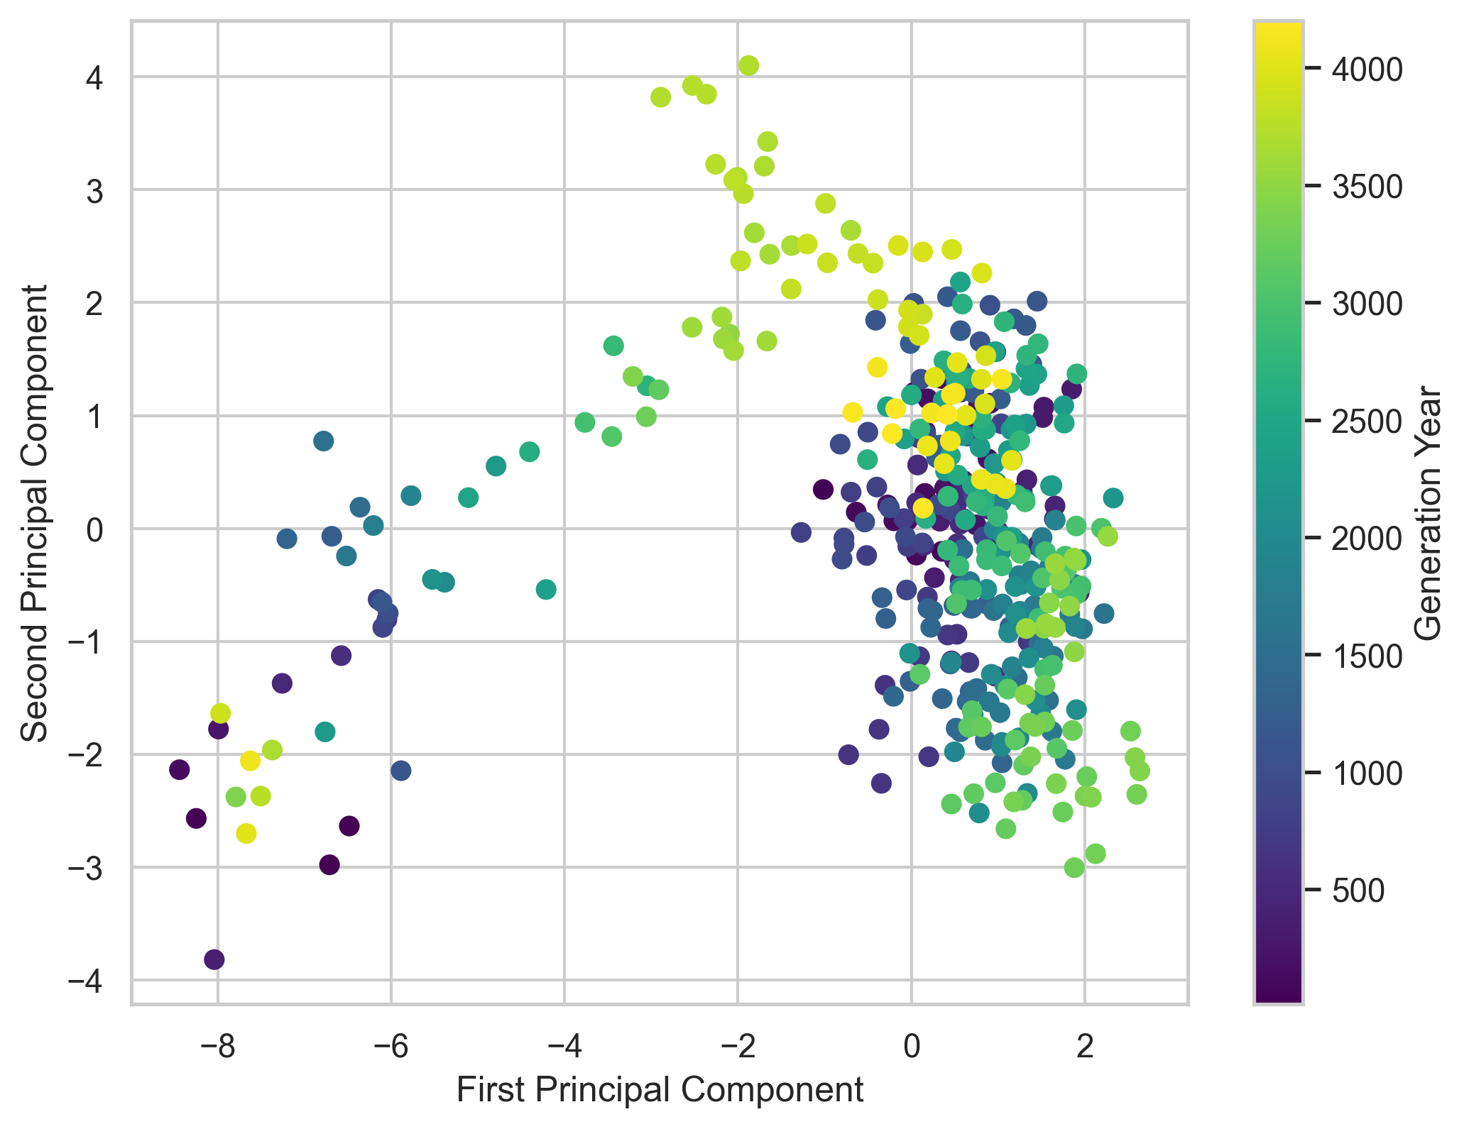
4389
3723
3654

Slide 14
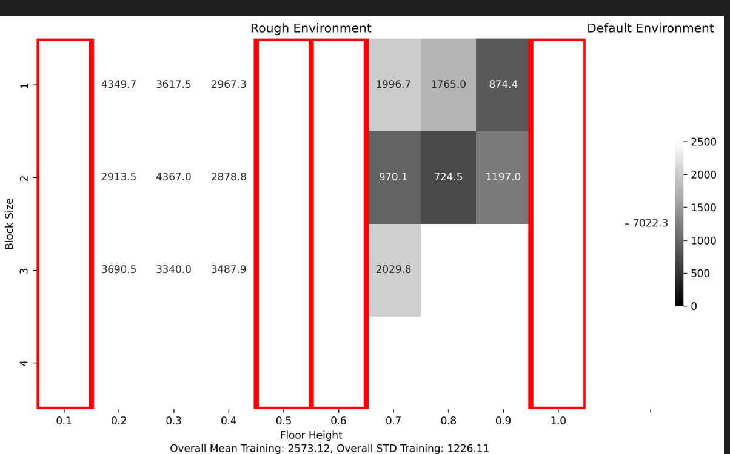
Experiment 3: specialists

